Slide 1
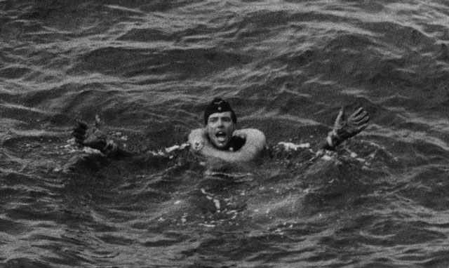
U-boat Prisoner Interrogation
Handling – Screening - Interrogation
Captain Jerry Mason, USN (ret.)
U-boat Archive Website http://uboatarchive.net

Slide 2
US POW Code of Conduct
Article I: I am an American, fighting in the forces which guard my country and our way of life. I am prepared to give my life in their defense.
Article II: I will never surrender of my own free will. If in command, I will never surrender the members of my command while they still have the means to resist.
Article III: If I am captured I will continue to resist by all means available. I will make every effort to escape and aid others to escape. I will accept neither parole nor special favors from the enemy.
Article IV: If I become a prisoner of war, I will keep faith with my fellow prisoners. I will give no information or take part in any action which might be harmful to my comrades. If I am senior, I will take command. If not, I will obey the lawful orders of those appointed over me and will back them up in every way.
Article V: When questioned, should I become a prisoner of war, I am required to give name, rank, service number and date of birth. I will evade answering further questions to the utmost of my ability. I will make no oral or written statements disloyal to my country and its allies or harmful to their cause.
Article VI: I will never forget that I am an American, fighting for freedom, responsible for my actions, and dedicated to the principles which made my country free. I will trust in my God and in the United States of America.

Slide 3
Canadian Code of Conduct after Capture
Preamble:
The aim of the Code of Conduct After Capture is for you to survive with honour;
Do not surrender to the enemy while you still have the means to achieve your mission;
If captured, remember you are still a member of the CF and remain subject to its rules and obligations.
Prescriptive set of five rules:
1) Principles of leadership;
2) Resist exploitation by all means available;
3) Information to be given;
4) Dignity and self respect must be maintained;
5) Escape

Slide 4
Commander U-boats Standing War Order No. 502
Instructions to Crews Regarding Secrecy
Secrecy:
On every suitable occasion the men are to be reminded of secrecy
Keeping of diaries is forbidden
Secrecy is a duty to ones comrades
Any contravention will be punished in the severest and most merciless fashion
Behavior in Captivity: Every time you put to sea the crew must be told:
Give no information on military questions – even false answers are not allowed
Give only his name and rating – no details such as Commanding Officer, etc.
Attempts must be made to let the command know when and how capture was made
In POW camps conversation among POWs is overheard by listening devices
U-570 was captured 5 May 1940 after being attacked by a RAF Hudson
Detailed description of the interrogation of a German Petty Officer in London
Prior to every sailing detailed instruction is to be given on this subject

Slide 5
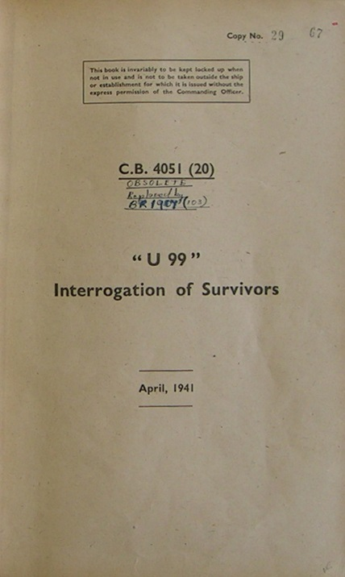
Interrogation Reports
There were about 104 UK and 60 US interrogation reports
Each contained:
Details of ship’s company
Details of the boat – armament and equipment
History of the boat -construction and patrols
Details of the sinking
Information on other
boats, ships and bases
Crew list
How did they do it?
Properly handled POWs
Carefully selected POWs
Trained interrogators
Specially equipped
Central Interrogation center

Slide 6
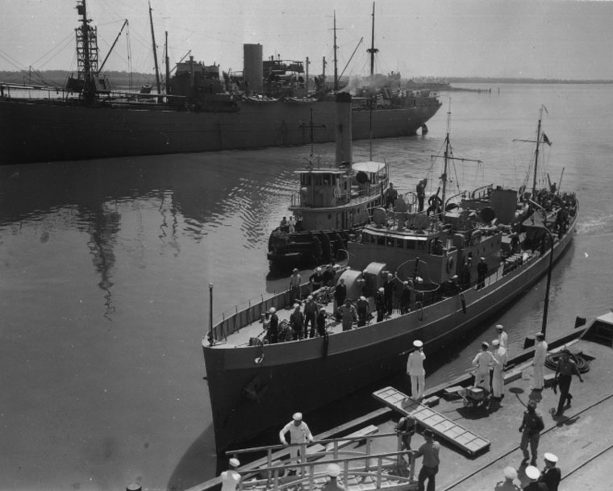
U-352 sunk by USCGC Icarus 9 May 1942
USCGC Icarus arrives at the Charleston Navy Yard 10 May, 1942, the day after sinking U-352

Slide 7
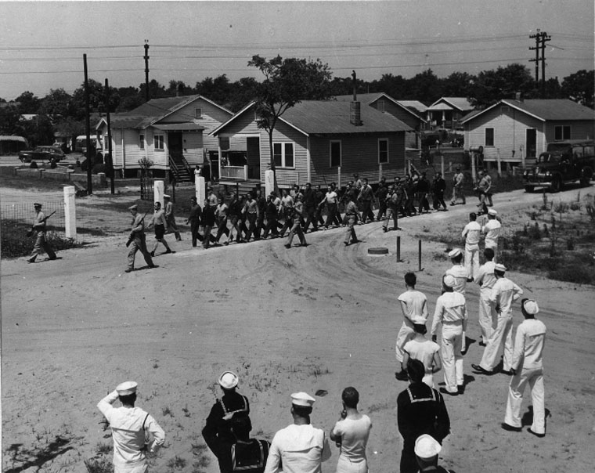
Rathke marches his men from Icarus to the mess hall at the Charleston Navy Yard

Slide 8
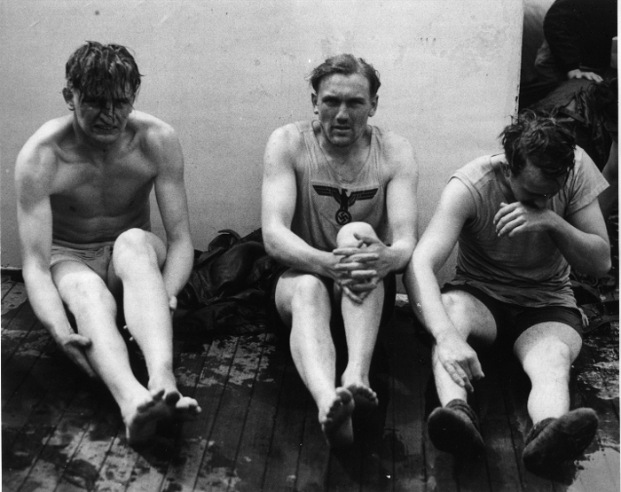
C.B. 3074 - Treatment and Handling of Prisoners of War in Ships Effecting Capture
“It should be remembered that the primary value of a prisoner lies in his being a potential source of information rather than an object for excessive solicitude.”
Prisoners show the shock and stress of capture

Slide 9
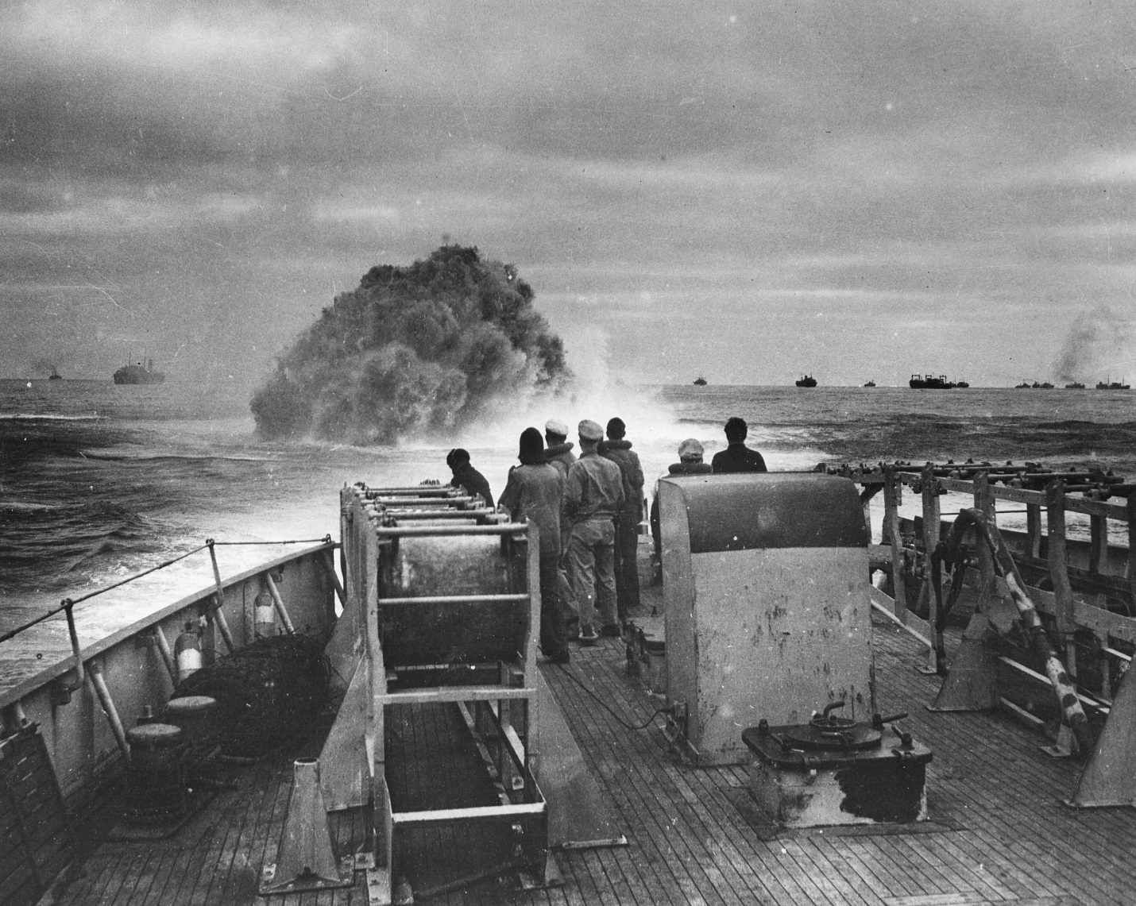
U-175 sunk by USCGCs Spencer and Duane 17 April 1943
Depth charges explode from Spencer’s initial attack on U-175
Ships of convoy HX-233 in the background

Slide 10
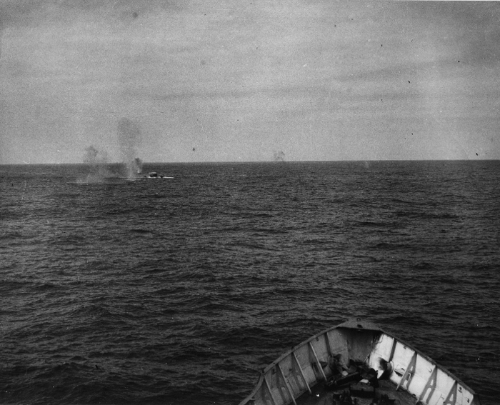
U-175 shelled by Spencer, Duane and ships of HX-233

Slide 11
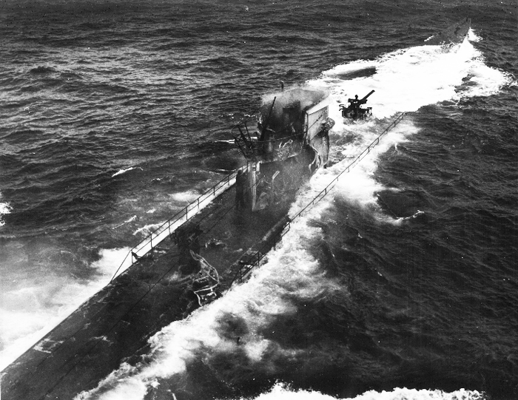
U-175 taken from Spencer’s bridge

Slide 12
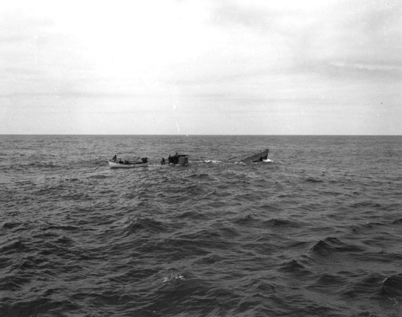
Spencer’s boarding party aboard U-175

Slide 13
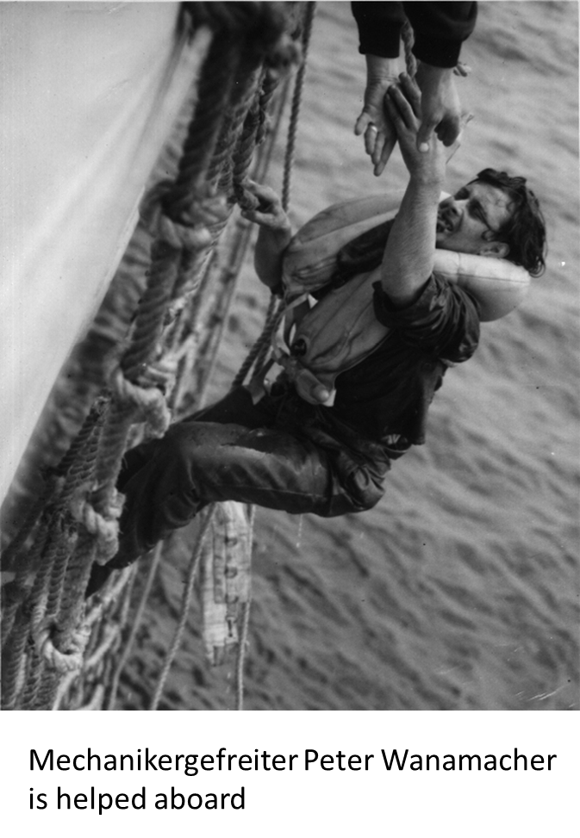
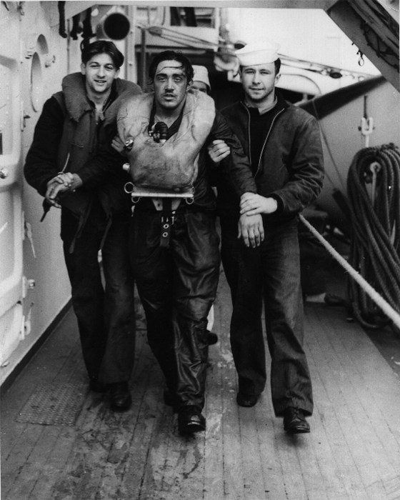
41 rescued by Spencer and Duane
Maschinengefreiter Otto Herzke is assisted by two Duane crewman.

Slide 14
Procedure for handling prisoners of war
Immediately after being received on board, prisoners shall be segregated into three groups – officers, non-commissioned officers and enlisted men – and placed under armed guard
In no case shall a prisoner officer be permitted to give orders or talk with any prisoner except in the officer group
No fraternizing or conversation between prisoners and ship’s company other than those detailed as interpreters
Prisoners shall be minutely searched and everything taken except for necessary clothing. Items will be made up into separate bundled and clearly marked
Prisoners shall be required to give their name, rank and service number, they are required to do this under the Geneva Convention, they are NOT required to give any other information unless they so desire
AFTER being segregated and searched prisoners shall be cared for physically i.e. given warm clothing, fed and given medical attention, cigarettes etc. - our first interest is in obtaining all information
Although some prisoners are eager to talk under the stress and shock of action, capture, there shall be no attempt to conduct a formal interrogation

Slide 15
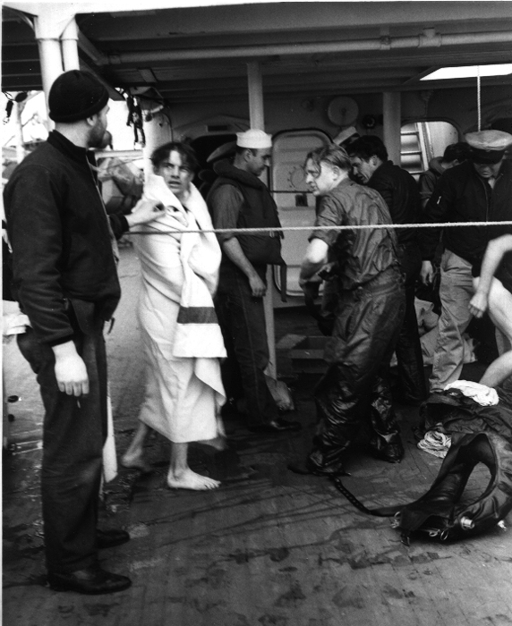
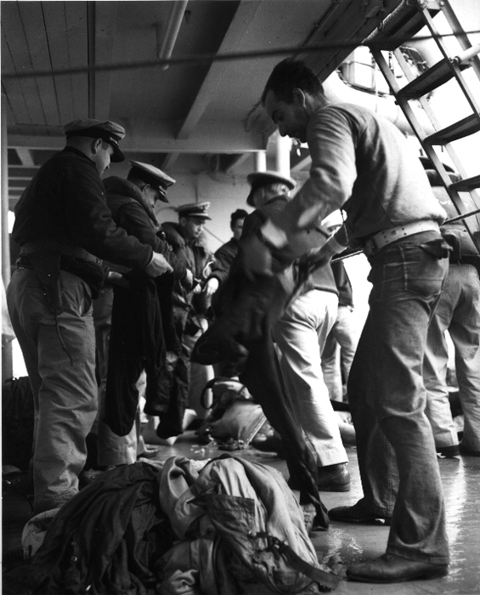
Prisoners' clothing and equipment is removed and searched for items of intelligence value.

Slide 16
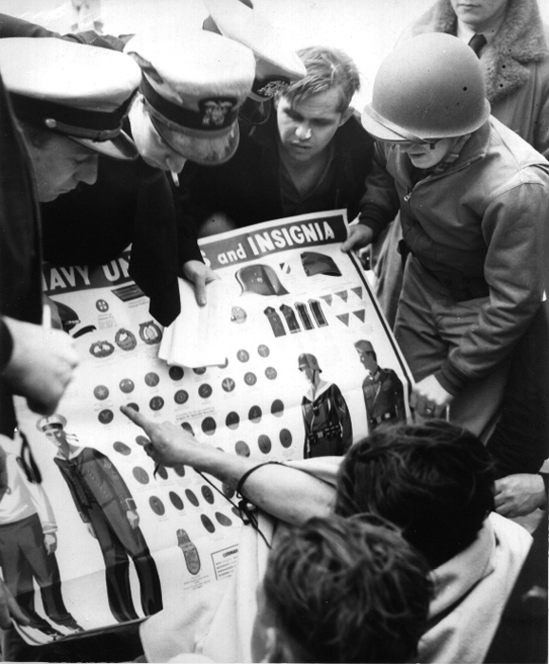
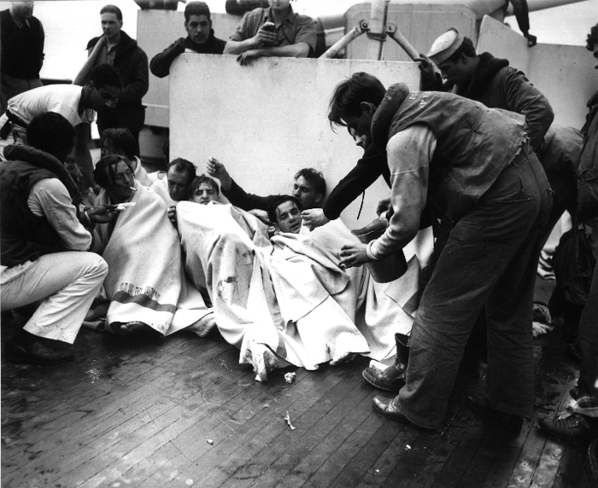
Prisoners point to their rank to help officers complete their identification.
When initial processing is complete, prisoners are given cigarettes and hot coffee.

Slide 17
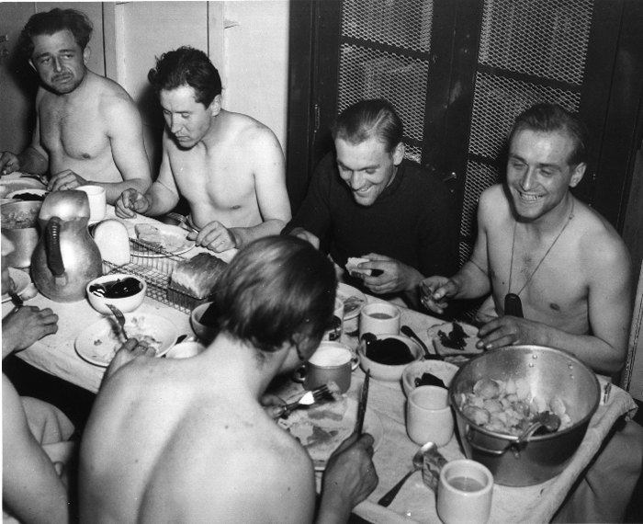
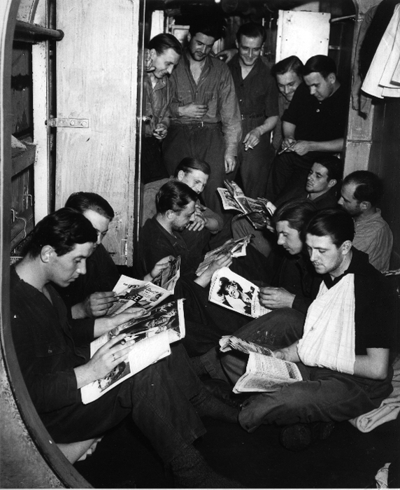
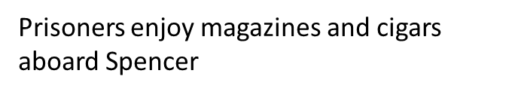
Back row, left to right: Maschinenmaat Erwin Geimeir, Mechanikersmaat Herbert Brunken, Maschinengefreiter Gustav Brückmann and Maschinenobergefreiter Walter Schroeder.

Slide 18
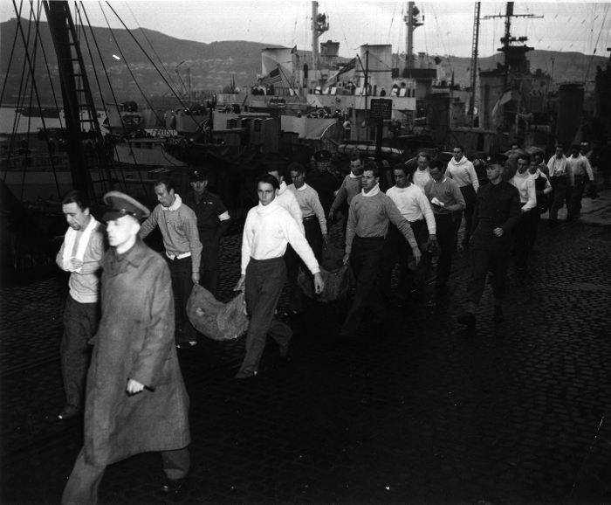
Prisoners from Duane and Spencer are handed over to British Marines on 20 April at the Royal Naval Base at Greenock-Gourock, Scotland.

Slide 19
Screening prisoners of war for detailed interrogation
Screening took place at the port of debarkation (Newport News, Brooklyn, or Boston)
Prisoners were photographed, fingerprinted and filled out the Basic Personnel Record
Officers conducting the screening were Interrogators from the Joint Interrogation Center
Prisoners filled out a questionnaire – with questions that far exceeded requirements of the Geneva convention
Prisoners usually accepted this form as an essential procedure and filled in the information
Interrogators made brief notes on the form and selected or rejected the prisoners
After the screening process was completed the interrogation officer prepared a Preliminary Interrogation Report
Selected prisoners were transported to a holding camp Ft. Meade, MD the rest directly to regular POW camps

Slide 20
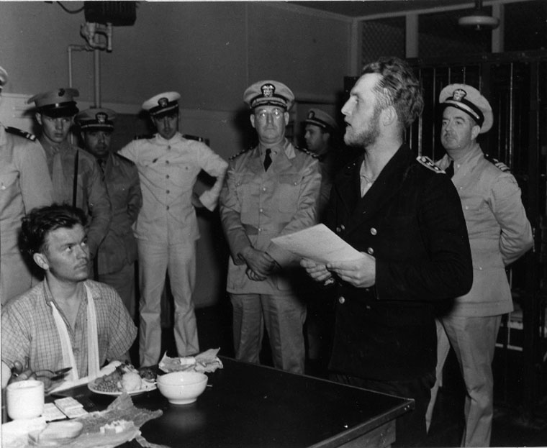
Leutnant zur see (Sonderführer) Oskar Bernhard, U-352 Navigator addresses the crew in the filling out of the Basic Personnel Record which he holds in his hands.

Slide 21
Basic Personnel Form - Werner Drechsler, U-118
War Department, Provost Marshal General Form No. 2

Slide 23
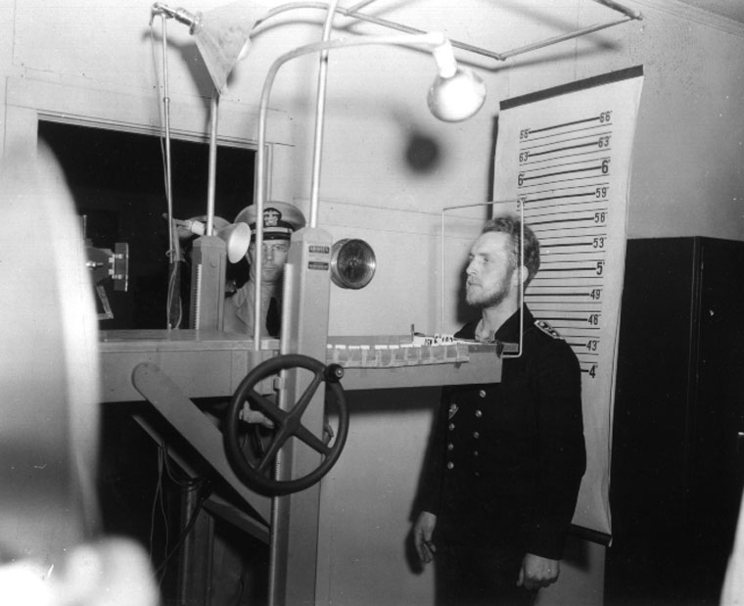
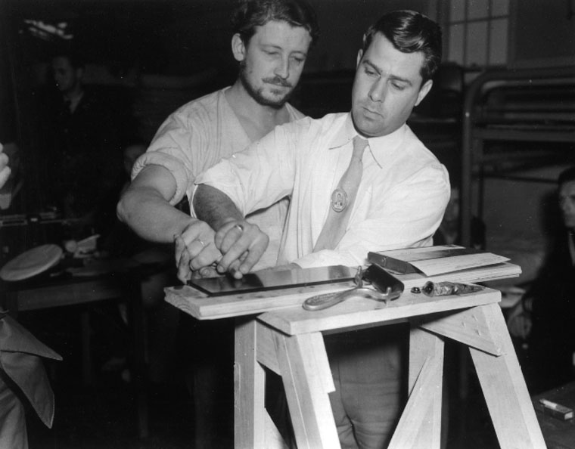
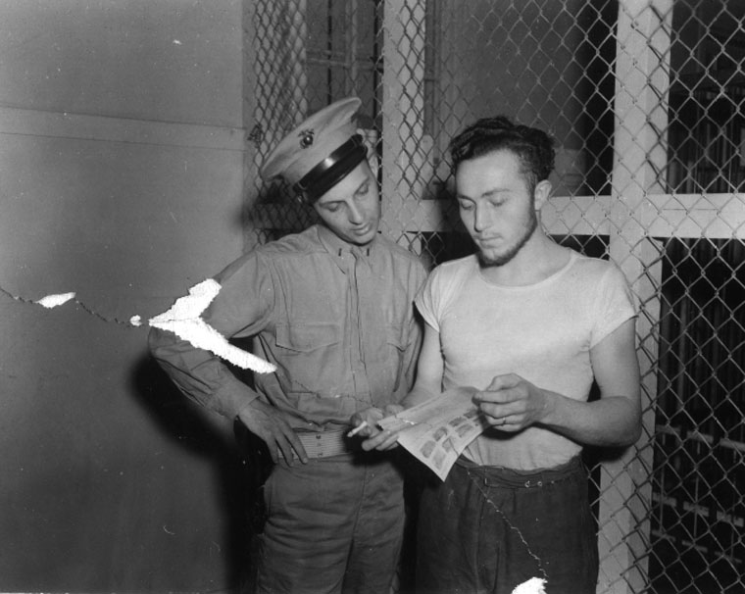

Slide 24
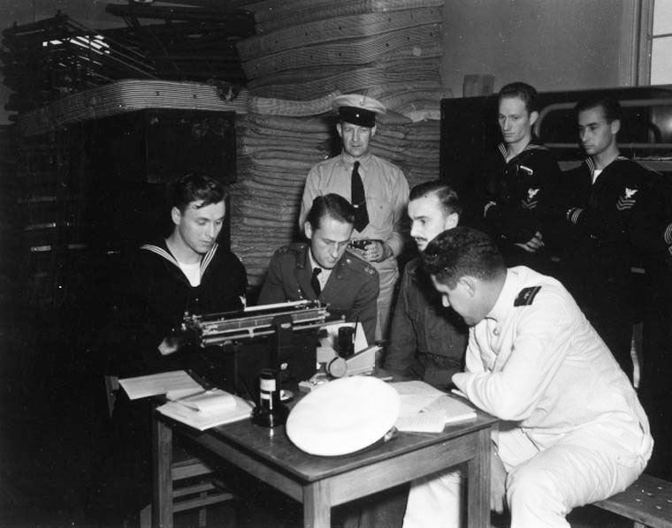
The Basic Personnel Record form is typed out - The British officer is Lieutenant Ralph Izzard, R.N.V.R. an exchange officer who trained the initial cadre of U.S. Navy Interrogators

Slide 25
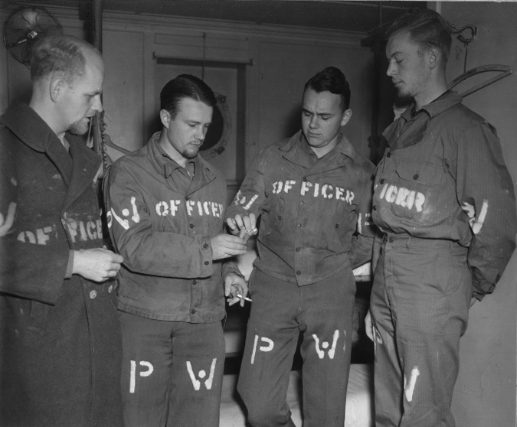
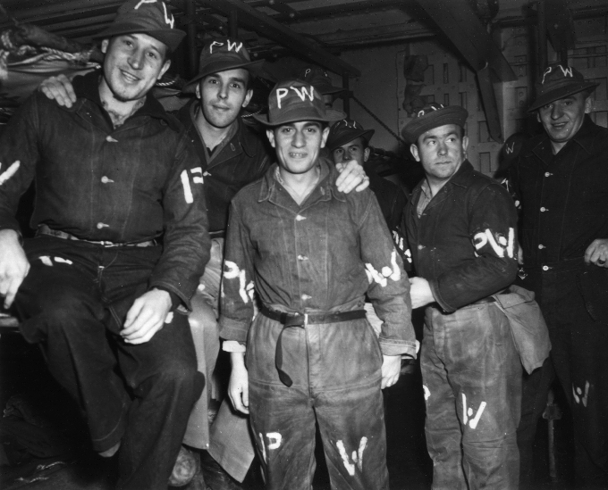
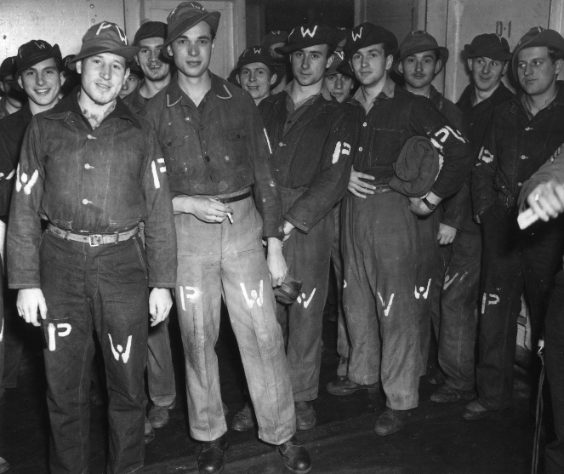
U-595 sunk by 7 RAF Hudsons off Algeria 14 November 1943
The Officers of U-595 (Left to Right) Jürgen Quaet-Faslem, Friedrich Kaiser, Emmerich Freiherr von Mirbach and Horst Eberhard von Horstig
Petty Officers
U-595’s crew was transferred to the USN and arrived Newport News, VA on 30 November 1942
Junior enlisted

Slide 26
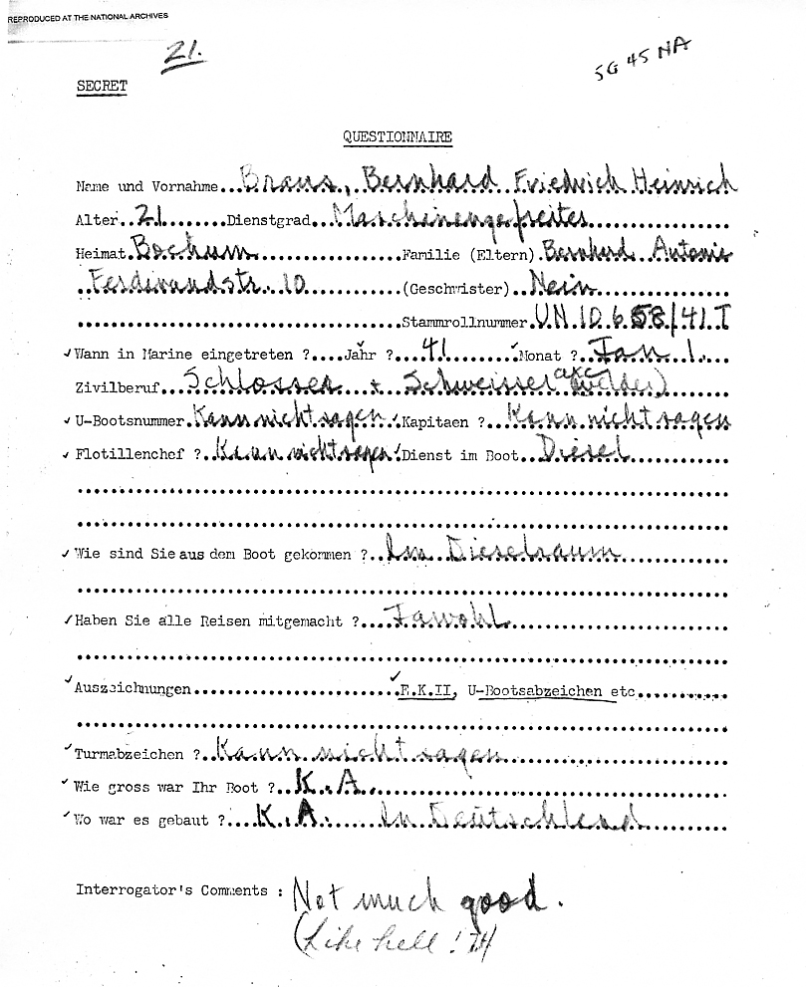
Name and forename _____
Age _____ service grade _____
Home ____ Family (parents) _____
Brothers and sisters _____
Service Number _____
When entered the Navy Year ____ Month ____
Civilian occupation _____
U-boat Number _____ Captain _____
Flotilla Comm. ____ Role in the boat ____
How did you get out of the boat? _____
Have you been on all the voyages? _____
Awards ___ Iron Cross II, U-boat Badge etc. ___
Conning tower emblem? _____
What size was your boat? _____
What year was it constructed? _____
Interrogator’s Comments : _____

Slide 27
Name | Rank/Rating | Stammroll Number | Serial Number | Screening Officer Comments | Selected for Further Screening
QUAET-FASLEM, Jürgen | Kapitänleutnant |  | 5G8NA | Very stiff. - (Somewhat melancholic) | Y
v. MIRBACH, Emmerich, Frh. | Oberleutnant (Ing.) |  | 5G9NA | Polite, friendly. Might talk. Favorable | Y
PRZYGODE, Herman | Obermaschinist | 0616/33 T | 5G12NA | Unwilling. Tough nut. Notice verbatim answers | N
JOSS, Friedrich | Funkmaat | UO 737/38 T | 5G20NA | Very fair possibility. Can be used. Timid. Recommended | Y
HORN, Gerd | Matrosengefreiter | UO 926/41 S | 5G24NA | Good. Prompt answers. Can be persuaded. | Y
BUNGE, Franz Richard Martin | Funkobergefreiter | UO 9683/40 T | 5G27NA | Typical radioman. Nothing to be expected. In case of two bad Funke take this one because Obergefreiter. | N
RAST, Werner | Maschinengefreiter | UN 10842/41 T | 5G29NA | Definitely to be used. Hesitated only very slightly. Good possibility | Y
GLUDING, Felix | Matrosengefreiter | UO 4302/41 S | 5G40NA | Fair possibility for talking but would not know much. | N
WAGNER, Fritz (Freidrich Wilhelm) | Matrose | UN 22319/41 T | 5G51NA | Has Hitler youth belt on. No good to us. | N

Slide 28
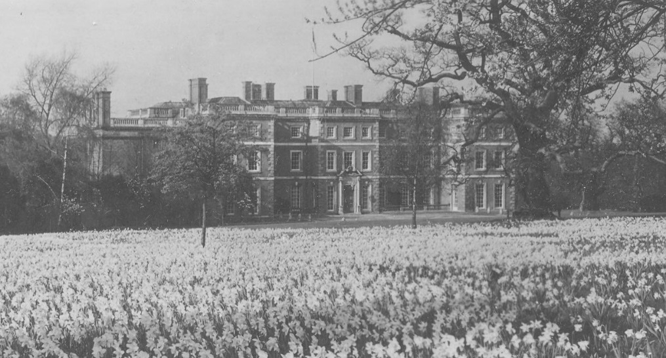
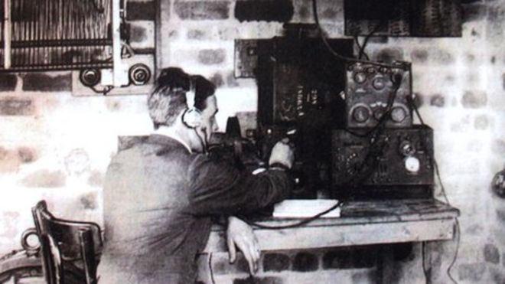
Combined Services Detailed Interrogation Centre (UK)
Opened in Oct 39 in the Tower of London, in Dec 39 moved to Trent Park, known as “Cockfosters Camp” or the London Cage, after 1942 various other locations
Selected prisoners of war of all three services
Comprehensive interrogation by specially qualified officers
Army responsible for guarding the camp and providing messing, clothing, etc.
6 Navy Interrogators and 2 clerks
Interrogation methods
Listening and recording
Employment of cooperative POWs
Direct interrogation
Trent Park – “Cockfosters Camp”
“Listener”

Slide 29
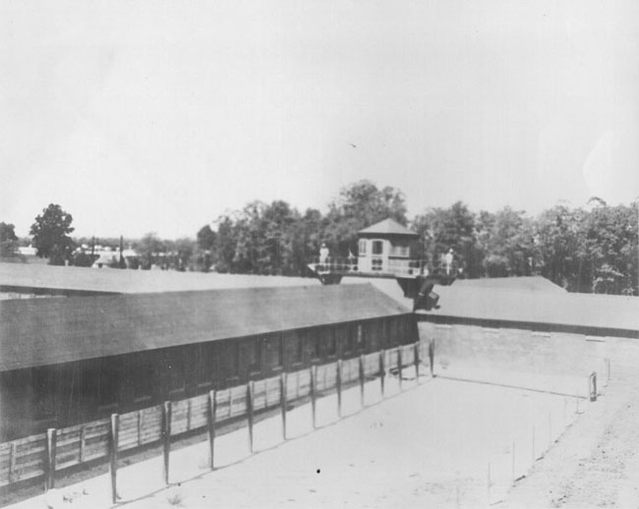
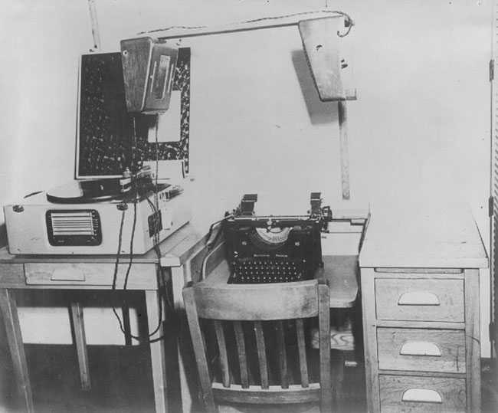
Joint Interrogation Center (US)
In 1941 US Army and Navy Officers visited the UK to observe POW Interrogation
Identical organization and interrogation methods as the UK
Fort Hunt near Washington DC opened July 42, Byron Hot Springs, Tracy California in Dec 42
Enclosure “B” and recreation yard
Listener station

Slide 30
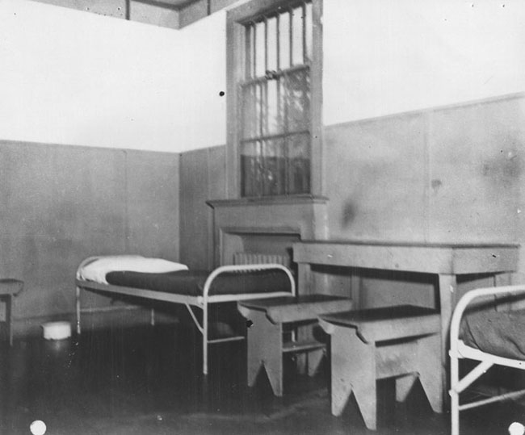
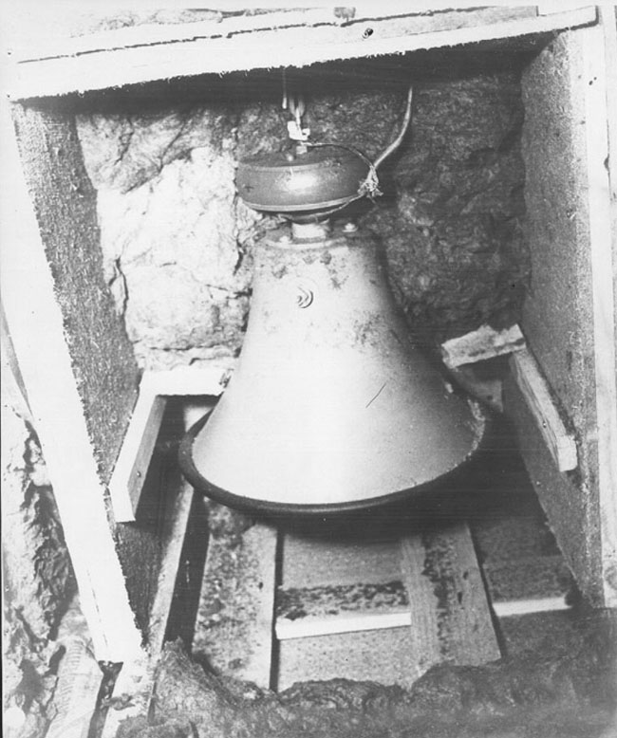
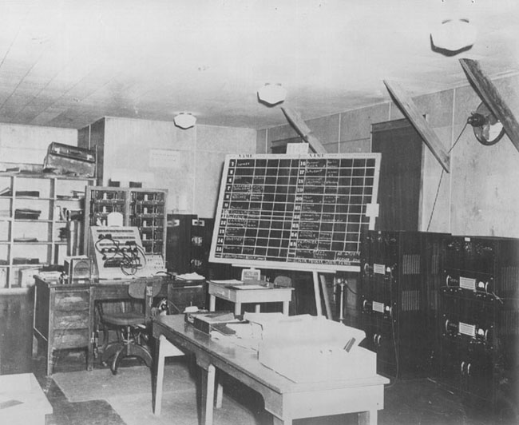
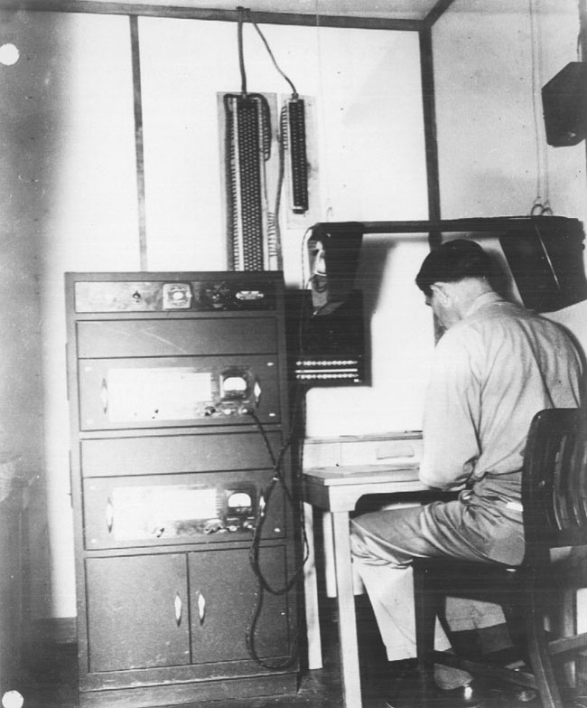

Slide 31
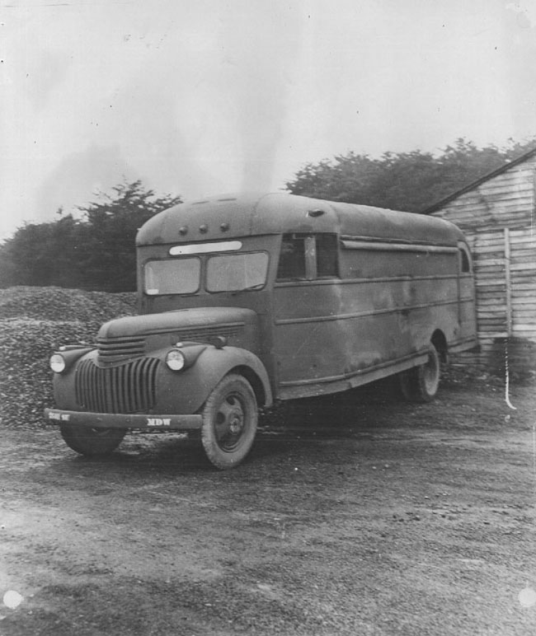
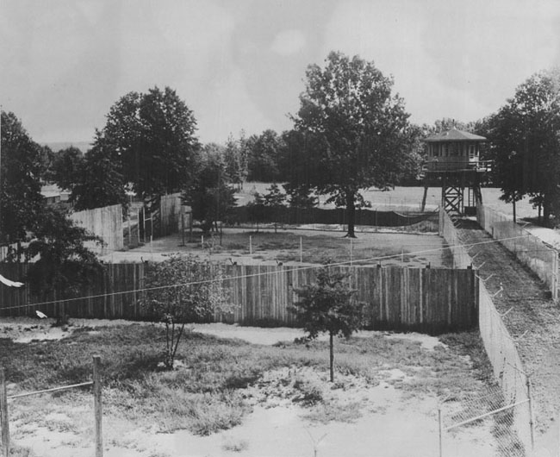
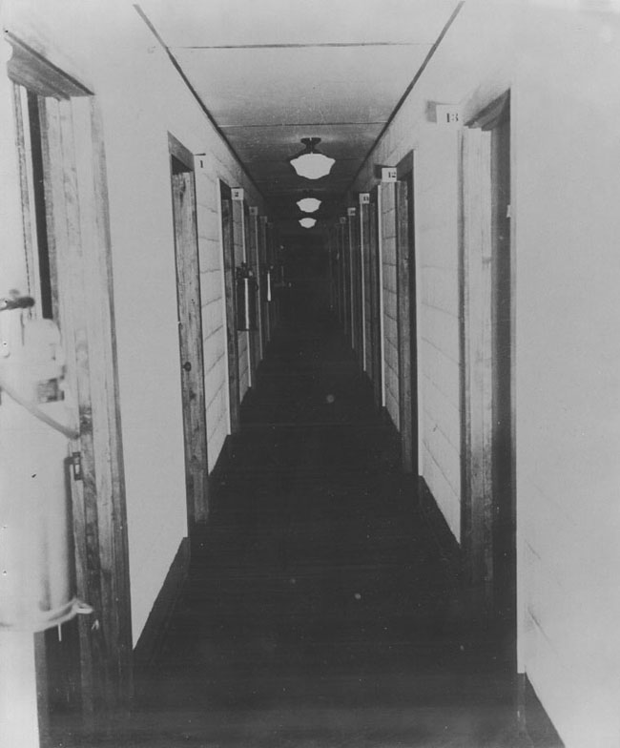
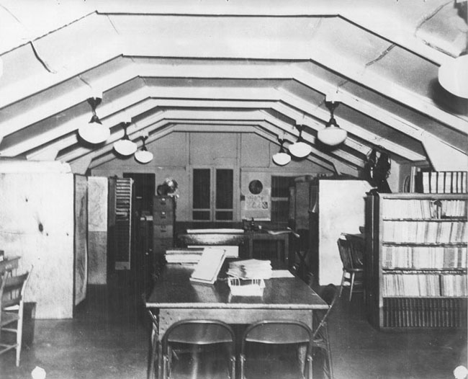

Slide 32
Selection and Training of Interrogation Officers
“Interrogation is psychological warfare waged between individuals, one determined not to talk and one determined to learn what is in his mind.”
Navy Section called for 28 interrogation officers, 2 civilian analysts, 6 yeoman
Most were already Reserve Intelligence Officers - 450 applicants - 26 selected
German speaking - fluent command of everyday language
Knowledge of Germany - folklore, habits, customs, manners and psychology
High cultural and educational background – never be below a prisoner intellectually
Able to impose his will on prisoners
Civilian occupations: language professors, newspaper men, lawyers, Mormon missionaries
UK Liaison Officer trained the initial cadre of US Interrogators
The center built up indexed files on U-boats: technical developments, bases, building yards, morale, history of each boat - and personnel: morale, friends, families, nicknames, weaknesses and strengths, hangouts
Adopted false identities and naval rank senior to the prisoner they were interrogating

Slide 33
Psychological Interrogation Techniques
Human beings are:
Talkative – especially after harrowing experiences
Differential when confronted by superior authority
Seek opportunities to rationalize acts about which they feel guilty
Under pressure (stress of capture) tend to forget what they have been taught
Attach less importance to information when someone else demonstrate they possess similar or related information
Appreciate flattery and exoneration from guilt
Resent belittling of cherished individuals or ideals
Likely to respond to kindness and understanding especially in unfamiliar circumstances
Tend to liberalize the rules in light of the situation they find themselves
Interrogation techniques:
Direct approach Stressing the futility of withholding information
Rapid fire questioning Emotional approach Good cop/bad cop
Variations (sympathy, sternness, pride and ego, national pride, face saving, bluff, fear)

Slide 34
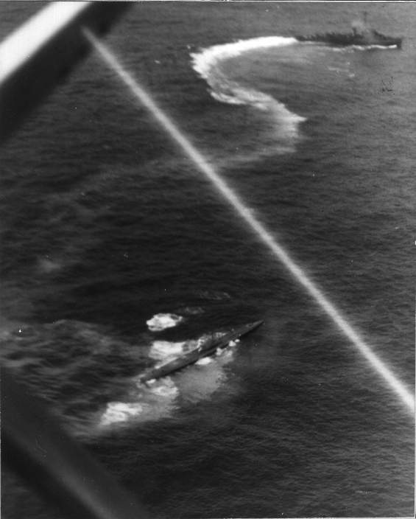
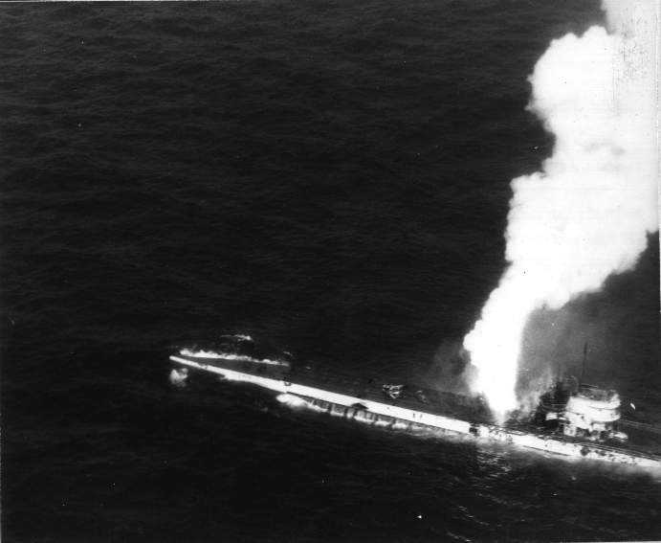
U-515 sunk by the Guadalcanal Task Group 9 April 1944

Slide 35
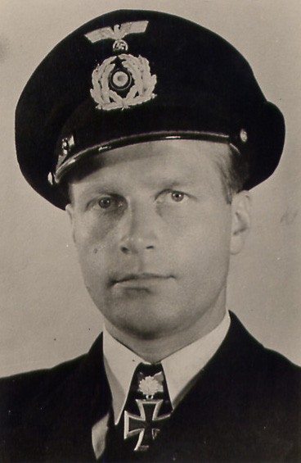
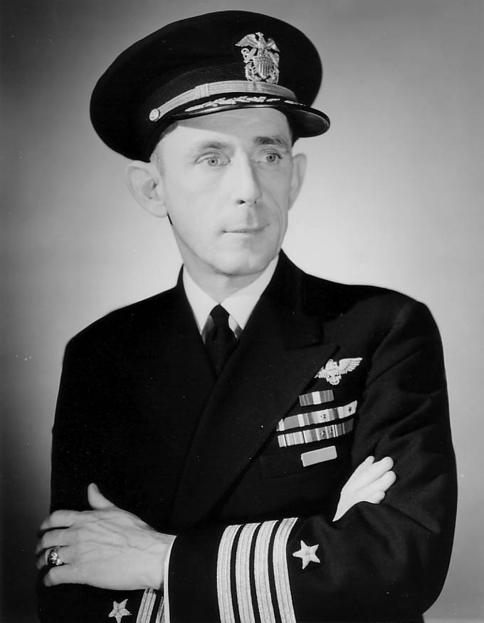
Korvettenkapitän Werner Henke
Knights Cross with Oak Leaves
27 ships (165,018 GRT)
Captain Dan Gallery
Commander Task Group 22.3
USS Guadalcanal

Slide 36
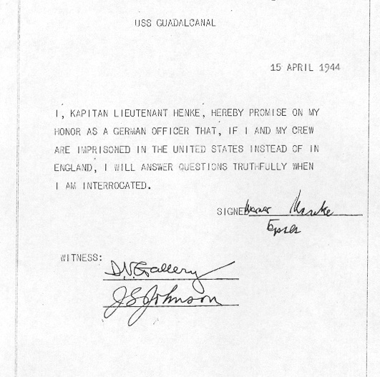

Slide 37
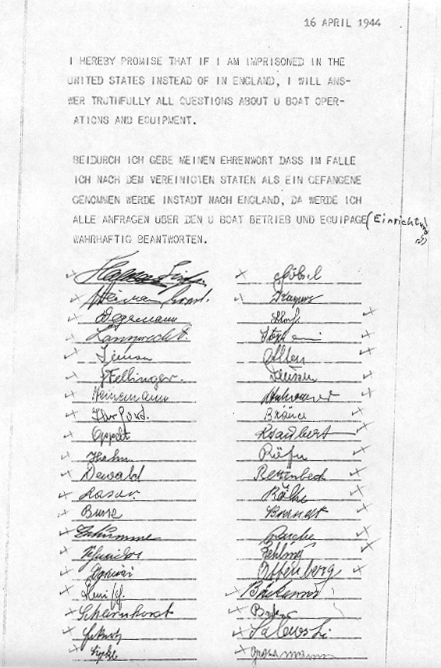
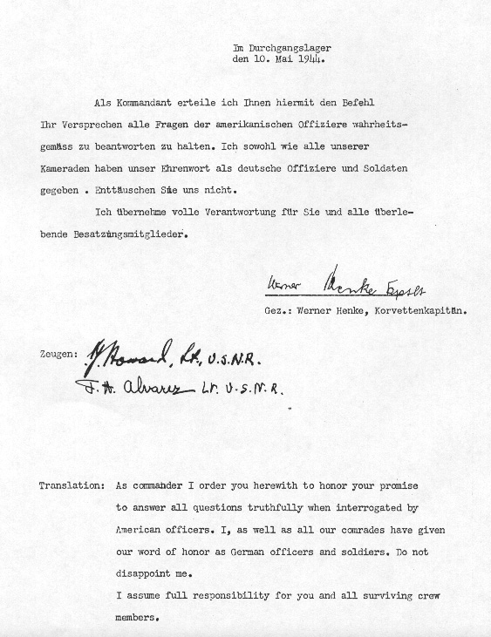

Slide 38
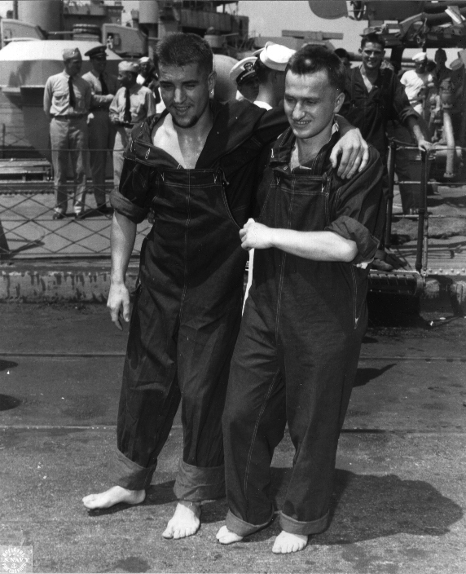
Cooperative POWs
Werner Dreschler (L), 23 year old torpedoman
from U-118, sunk 12 June 1943
Cooperated with interrogators for 7 months
Assumed 2 false identities – Limer and Brabant
Engaged POWs from 9 other boats in conversation
After his usefulness was exhausted he was sent to Papago Park POW Camp where many U-boat prisoners were held
Within 6.5 hours he was recognized by other U-boat men as a traitor and killed
Seven U-boat POWs were changed with murder, court martialed and executed
Told Richard Whittingham's excellent book Martial Justice, The Last Mass Execution in the United States

Slide 39
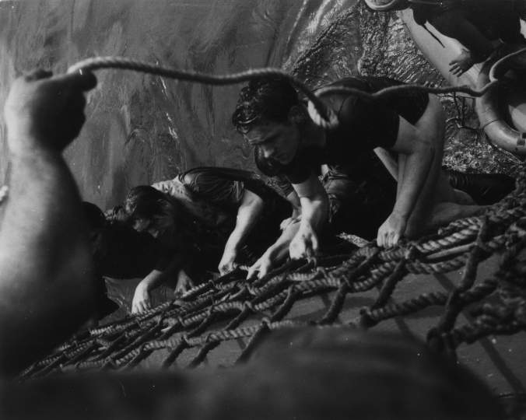
The End
Learn more about U-boats including interrogation reports, attack reports and the war diaries of boats at the U-boat Archive website: http://uboatarchive.net
Download the presentation at: http://uboatarchive.net/Presentations/Presentations.htm

